Slide 1

Rent Quest
Your Quest, Our Analysis
U.C.Berkeley Bootcamp Apr 2019
Prem Ganesh, Amitava Samadar, Jason Zaleya
& Suvrangshu Ghosh

Slide 2

Finding a perfect rental at Bay Area
Where to look ?
Which web has better and most listings??
Which location has more availability?

Slide 3

Our Quest
We pulled rental data from major web site
Craigslist.org

Slide 4

API calls to web
Called API’s using multiple locations to get rental data
Picked multiple available rental locations at Bay area
Processed more that 14000 records

Slide 5

Data Selection & cleanup
Cleanup process
Multiple data scan
Removed special characters
Removed null value
Text to integer conversion
Description
Price
Selection Process
Location
Number of rooms
Geo Tags

Slide 6
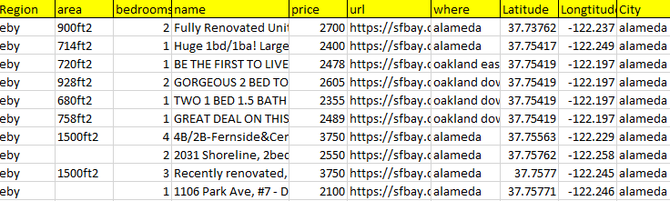
Final Data
The data is converted to structured csv files and then stored in MongoDB
Craigslist

Slide 7
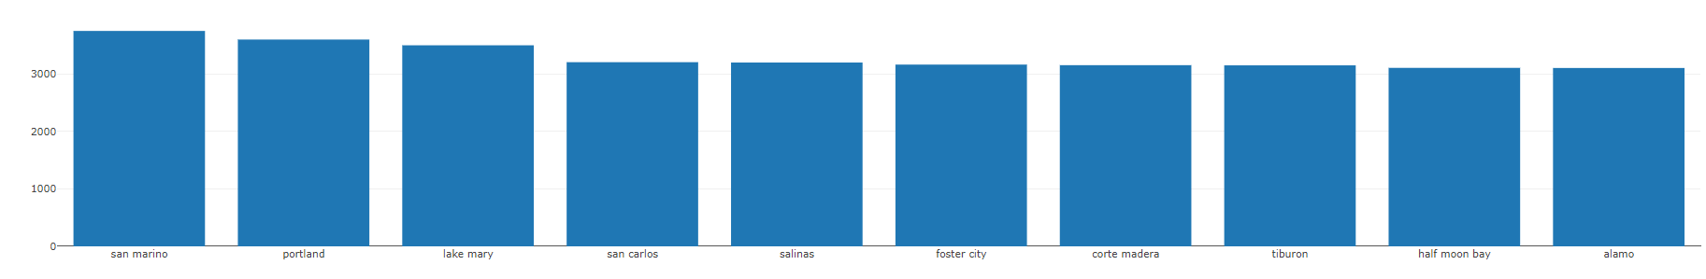
Benefit
Availability Vs Locations
From the data, many helpful analysis can be derived.
Which web has most listings?
Which location has cheap rentals?
Average Price
Which location has high rent?

Slide 8

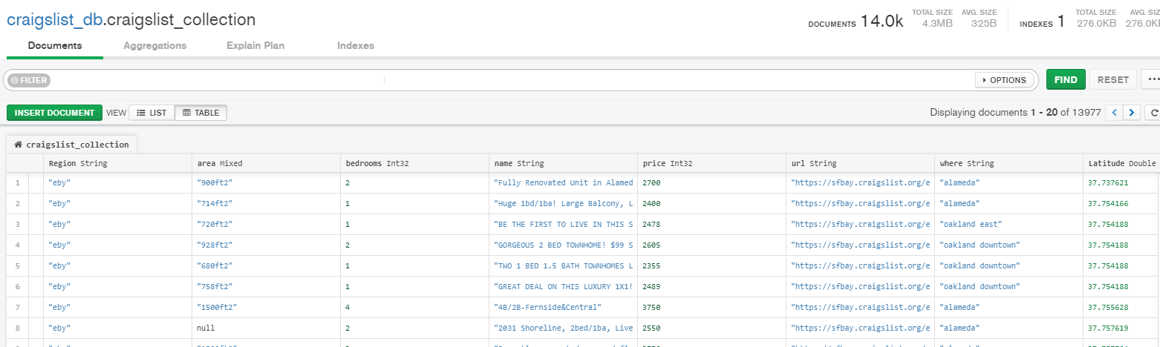
Database - mongodb
Showing collections Craigslist

Slide 9
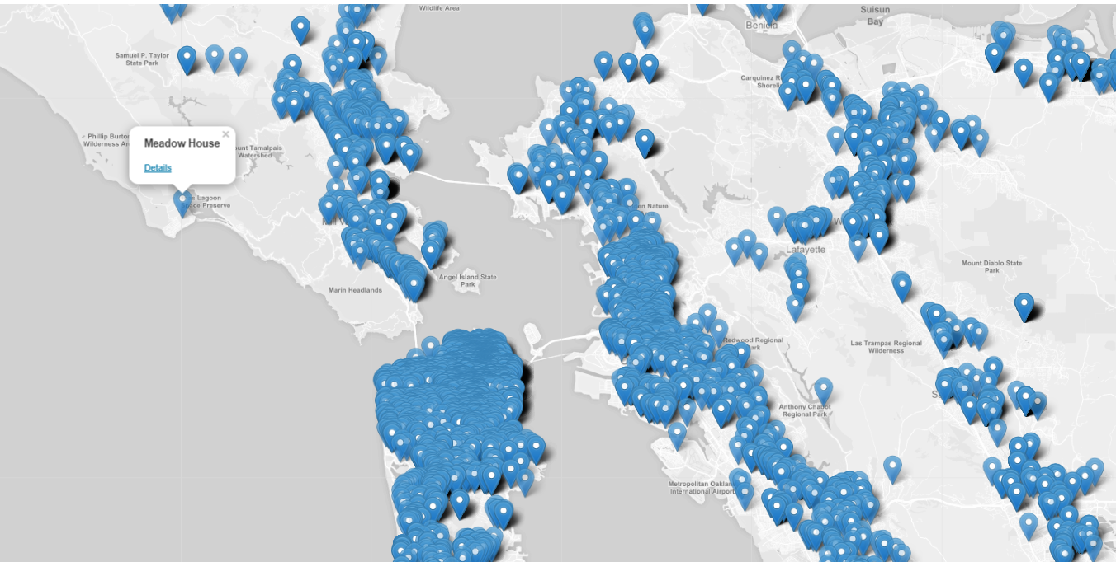
Data visualizations using D3, Leaflet

Slide 10

THANK YOU!

